Slide 1


Soil Water Balance Overview
University of Neuchâtel, Switzerland
Centre for Hydrogeology and Geothermics
December 16-20, 2019

Slide 2
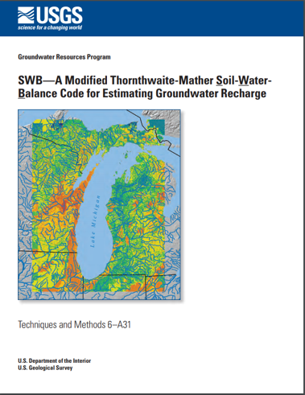
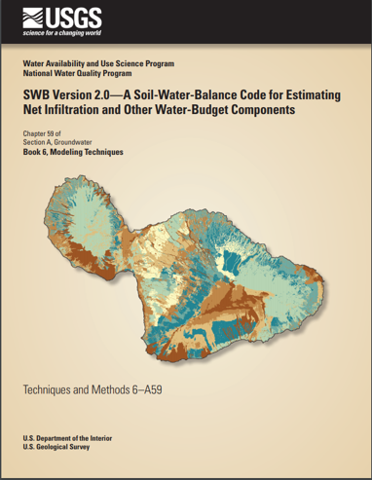
SWB – Modified Thornthwaite-Mather Soil-Water-Balance Code for estimating Water-Budget Components

Slide 3
Thornthwaite and mather

Slide 4
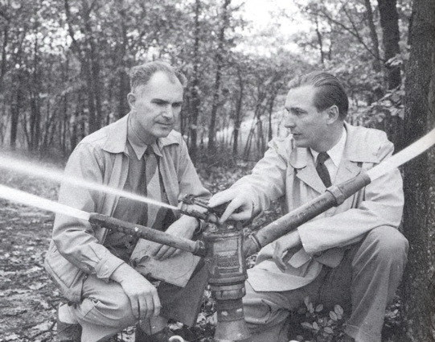
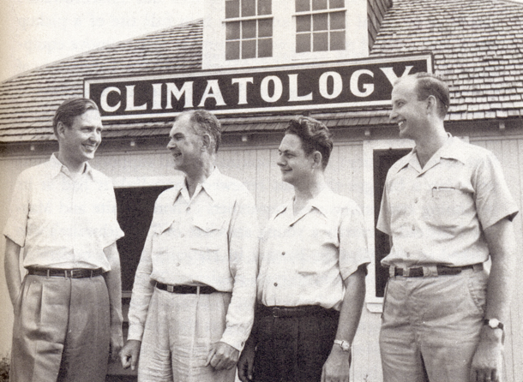
Thornthwaite and Mather: work originated with research on crop growth and yield at Seabrook Farms, New Jersey
Thornthwaite
Mather

Slide 5
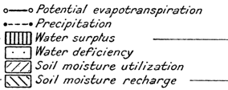
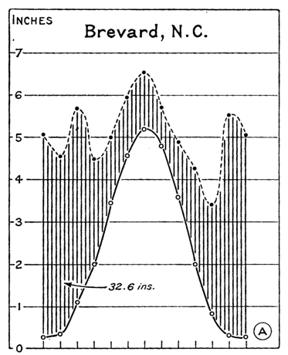
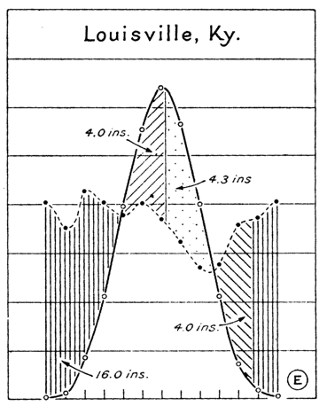
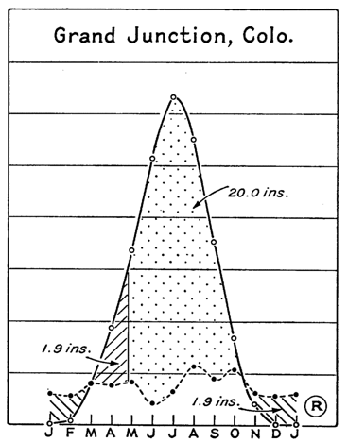
Thornthwaite’s march oF
precipitation and potential evapotranspiration
Modified from: Thornthwaite, 1948
Notes:
From Thornthwaite’s commentary (1948):
In Brevard, N. C. (Fig.4-A), less than half an inch of water is needed in each of the winter months. The need rises rapidly during the spring, reaches a high point of more than 5 inches in July, and falls rapidly during the autumn. The total average annual water need is 28.50 inches. The precipitation ranges from less than 3.5 inches in November to more than 6.5 inches in July and is greater than the need in every month. The total average annual precipitation is 61.06 inches, more than twice the potential evapotranspiration.
In Louisville, Ky. (Fig.4-E), rainfall is fairly uniform through the year-between 3.5 and 4 inches a month except in autumn, when it falls below 3 inches. Since potential evapotranspiration is not uniform, however, there is a surplus of water in winter and a deficiency in summer, just as in North Head (Fig.4-D) and Seattle (Fig.4-F).
In Grand Junction, Colo. (Fig.4-R), rainfall is slight throughout the year. Water supply satisfies less than one-third of water need, and deficiency is very large. The climate is arid.

Slide 6
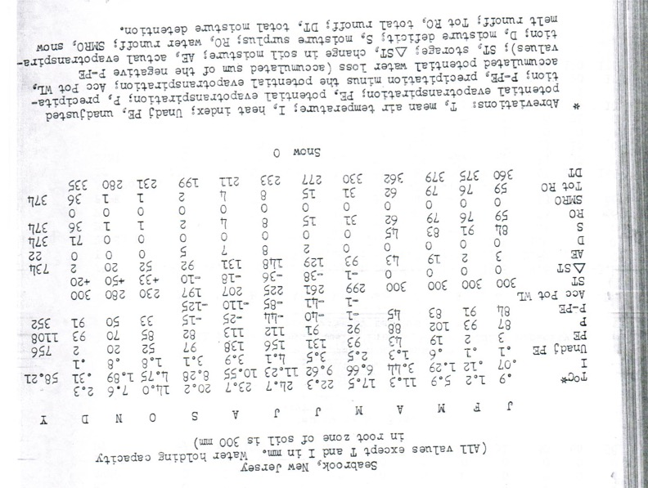
SWB: Modified Thornthwaite-Mather water balance
Potential evapotranspiration (PE)
Precipitation (P)
P – PE
Accumulated Pot. Water Loss
Soil storage
Actual evapotranspiration
Deficit
Surplus
Runoff
Snowmelt runoff
Source: Thornthwaite and Mather, 1957

Slide 7
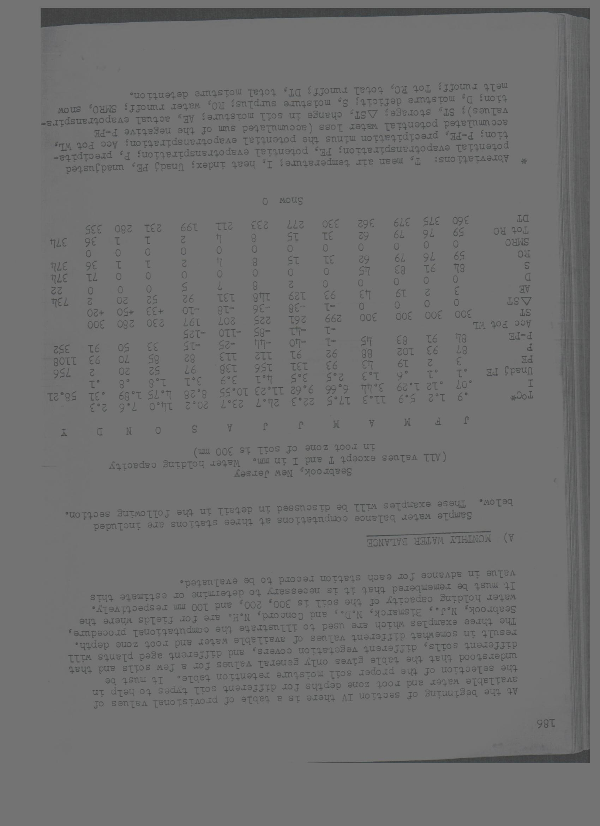
Thornthwaite’s march of precipitation and potential evapotranspiration
“From a comparison of the seasonal march of precipitation with evapotranspiration, the magnitude of other related moisture parameters, the water surplus, water deficit, soil moisture storage, and water runoff may be determined.”
Source: Thornthwaite and Mather, 1957
net infiltration (recharge),

Slide 8
Components

Slide 9
SWB methods and storage reservoirs

Slide 10
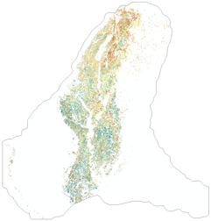
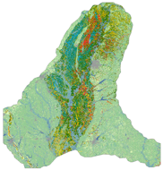
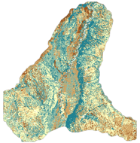
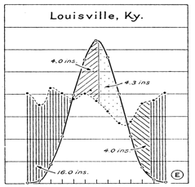
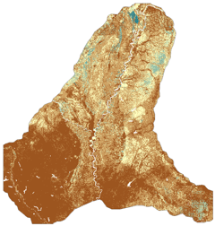
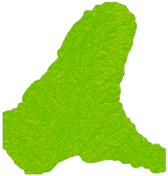
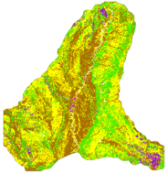
SWB data flow
Irrigation
Water Content
Land Use
DayMet, PRISM, or other gridded PRECIPITATION, AIR TEMPERATURE
Recharge
Flow Direction
Hydrologic Soils Group

Slide 11

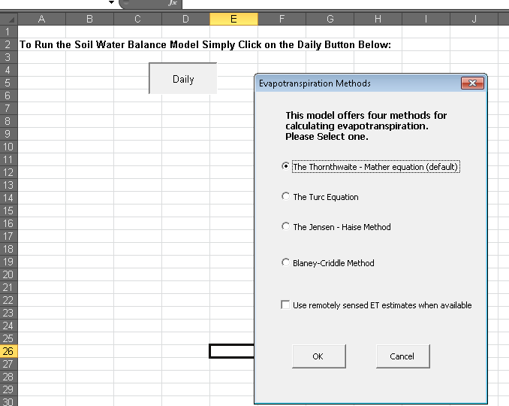
Evolution of SWB…
Dripps, W., 2003, The spatial and temporal variability of groundwater recharge within the Trout Lake basin of northern Wisconsin: United States -- Wisconsin, The University of Wisconsin - Madison.
https://github.com/smwesten-usgs/swb2

Slide 12
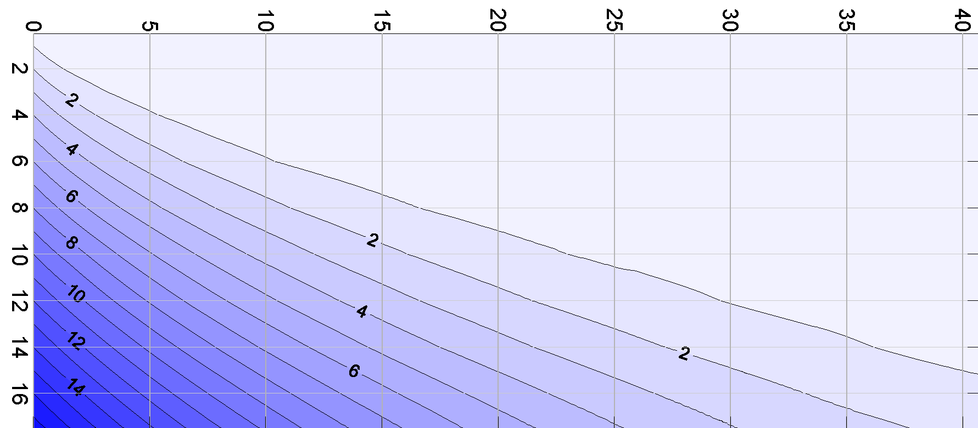
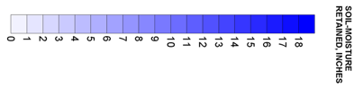

how much moisture can be pulled from the soil?
Maximum Soil Moisture Capacity
Accumulated Potential Water Loss (APWL)
$$APWL=\sum{\left(precip −potET\right)}$$
Source: Thornthwaite and Mather, 1957

Slide 13
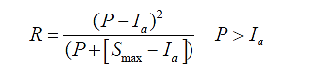
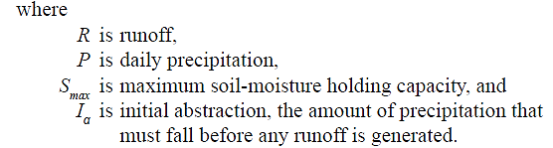
Runoff: SCS curve number
units are inches, of course!

Slide 14
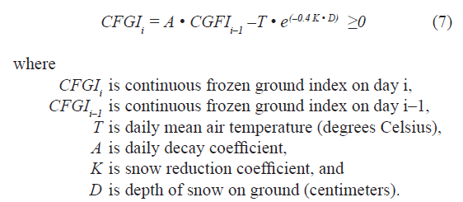
Continuous Frozen Ground Index (CFGI)
K=0.5 for above freezing conditions; K=0.08 if below freezing
A = 0.97
Source: Molnau and Bissel (1983)

Slide 15
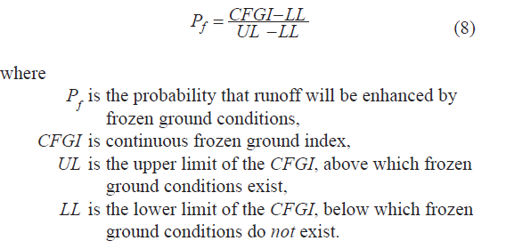
CFGI is used to increase runoff during frozen ground conditions to adjust curve number
Molnau and Bissel (1983) suggest starting with values of
56 and 83 for the LL and UL, respectively.

Slide 16
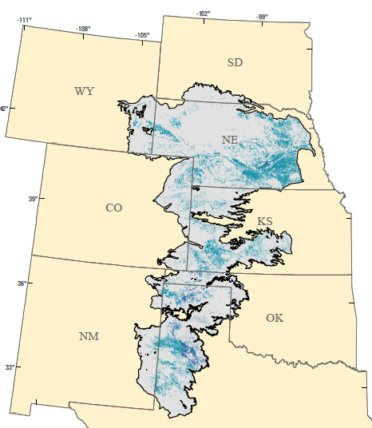
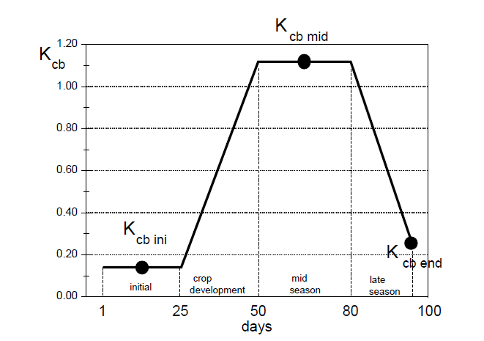
Estimating the effect of irrigation
Source: Allen and others (1998), FAO Irrigation and drainage paper 56

Slide 17
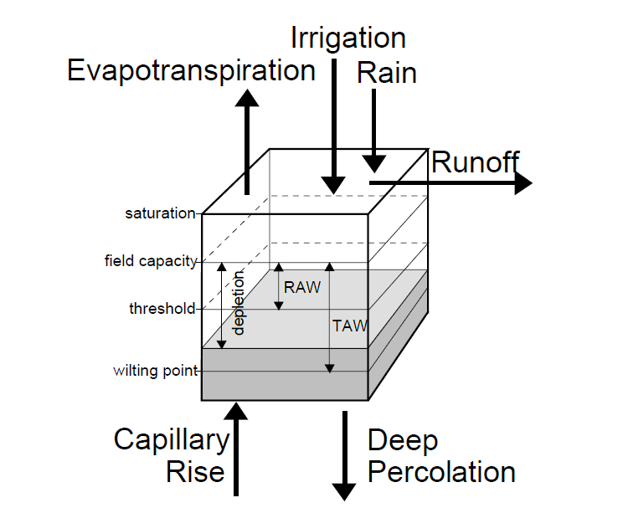
swb: irrigation demand
Source: Allen, R.G., Pereira, L.S., Raes, D. and Smith, M., 1998, Crop evapotranspiration-Guidelines for computing crop water requirements-FAO Irrigation and drainage paper 56: Rome, Food and Agriculture Organization of the United Nations, accessed May 5, 2011, at http://www.fao.org/docrep/X0490E/x0490e00.htm#Contents.

Slide 18
crop ET calculation
Plant growth
Bare soil evap

Slide 19
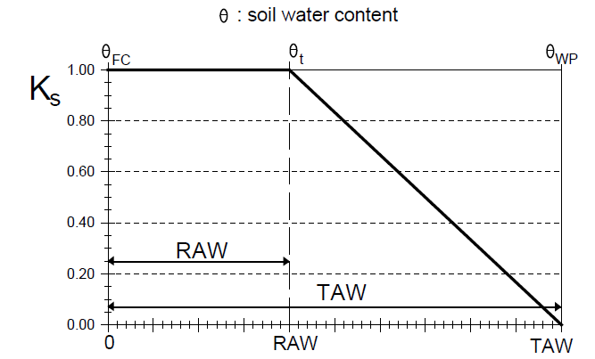
water stress coefficient Ks
Source: Allen and others (1998), FAO Irrigation and drainage paper 56

Slide 20
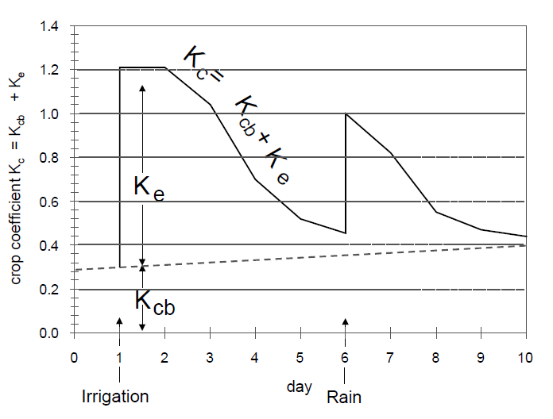
effect of dual crop coefficient Kc
Source: Allen and others (1998), FAO Irrigation and drainage paper 56

Slide 21
Constraining to reality

Slide 22
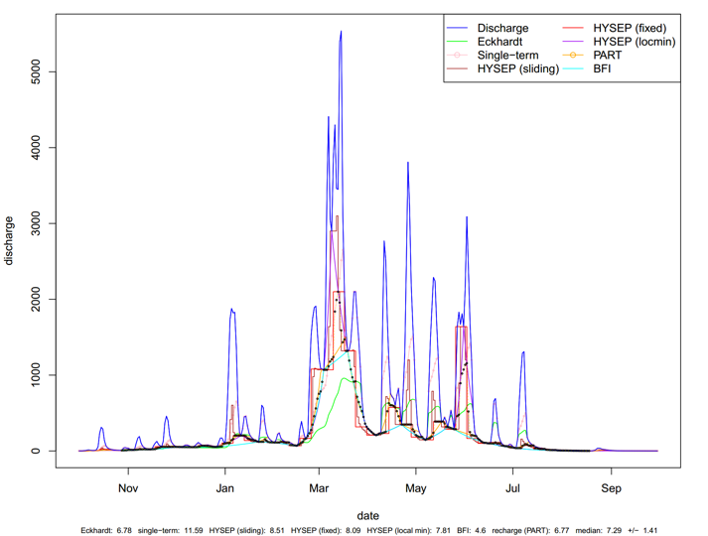
Baseflow separation to estimate recharge

Slide 23
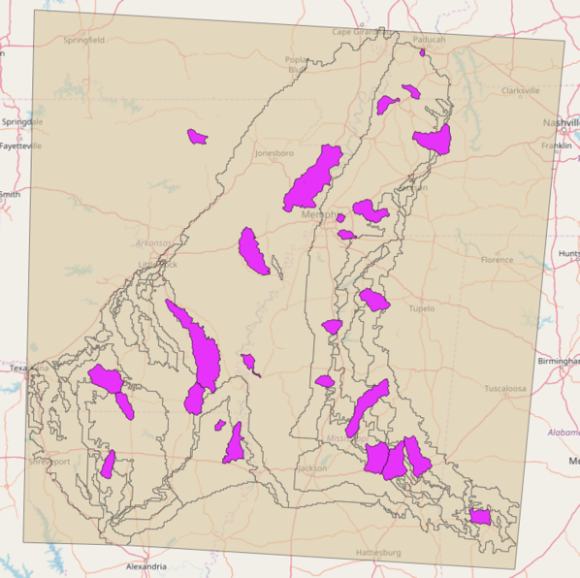
Contributing area of gages used in baseflow separation

Slide 24
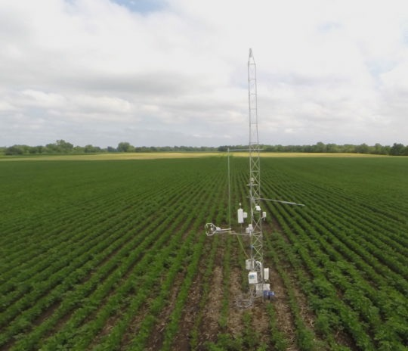

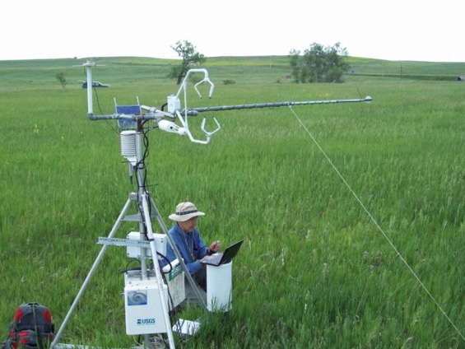
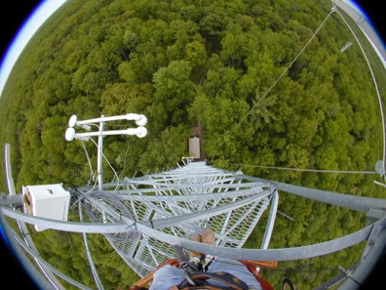
Constraining Actual ET With “Observations” (if you got hella cash)
Credit: William Breiter, site US-Ro5
Credit: Charlie Krinsky, site US-RFE
Credit: Christoph Vogel, site US-UMB

Slide 25
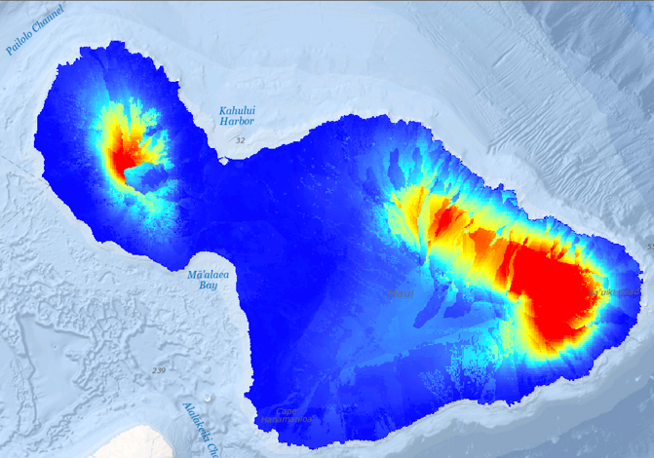
SOIL WATER BALANCE 2.0
Same features as the original SWB plus:
Modules to simulate processes important to tropical island hydrology
Optimized for non-rectangular areas of interest
netCDF4 input and output
Geospatial transformations on-the-fly
Redesigned to allow for easier addition of new process modules
Crop irrigation demand estimated using FAO-56 methodology
SWB: Grid-based code designed to estimate potential groundwater recharge, taking full advantage of gridded land use, soils, and climate datasets.

Slide 26
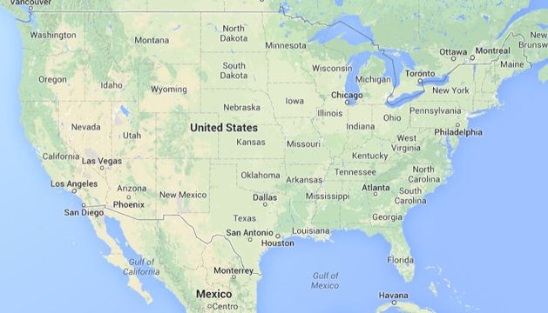
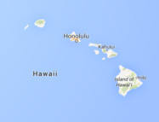
Select SWB Application Sites in the U.S.: 2012-2018
Williston and Powder River Basins
Bayfield Peninsula
Little Plover River
Tomorrow / Waupaca River
(irrigation)
State of Minnesota
Chippewa County
(frac sand mining)
Pacific Northwest Volcanic Aquifer System
State of Maine
Oregon
Lakes
Water
Budget
Non-USGS applications:
Catalina Island, CA
Mexico
Brazil
Suriname
Spain
Nigeria
South Korea
North Atlantic Coastal Plain
Glacial Aquifers
State of Wisconsin
(in support of statewide
stream temperature modeling)
Mississippi Alluvial Plain
Appalachian Plateaus
(New York-Georgia)
Hawaii Volcanic-Rock Aquifers
Upper Colorado
River Basin
Floridan Aquifer
High Plains Aquifer
Elkhorn-Loupe

Slide 27
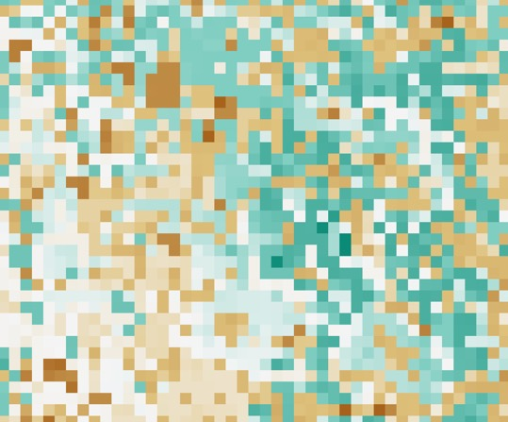
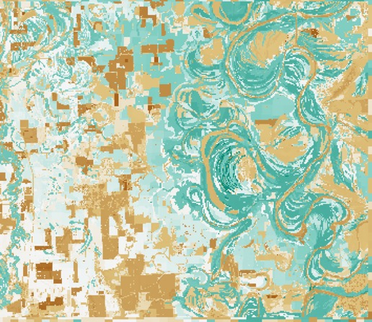
Running SWB for different areas of interest and different grid cell resolutions is easily done
1000-meter grid
100-meter grid
SWB inset model for Shellmound, Mississippi

Slide 28
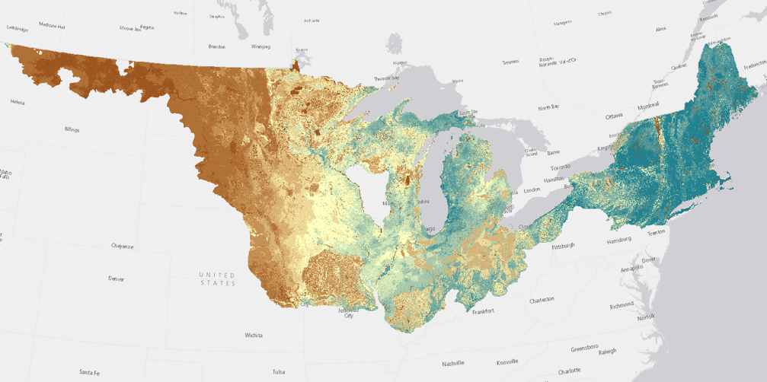
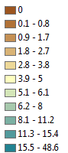
SWB-derived potential recharge 2000-2009
Deep percolation
in inches

Slide 29
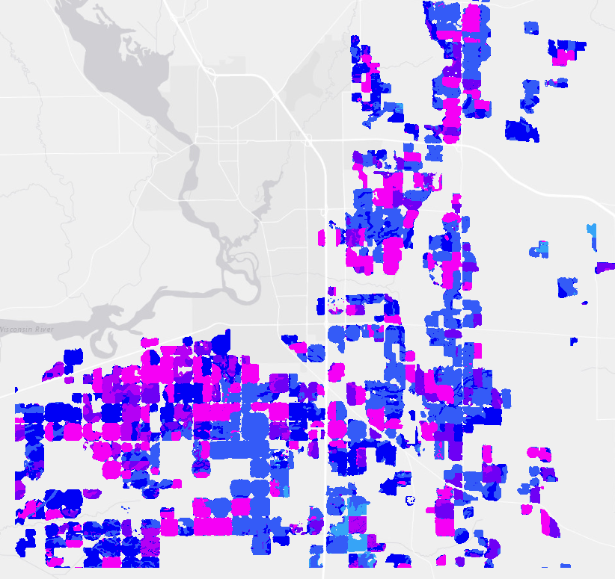
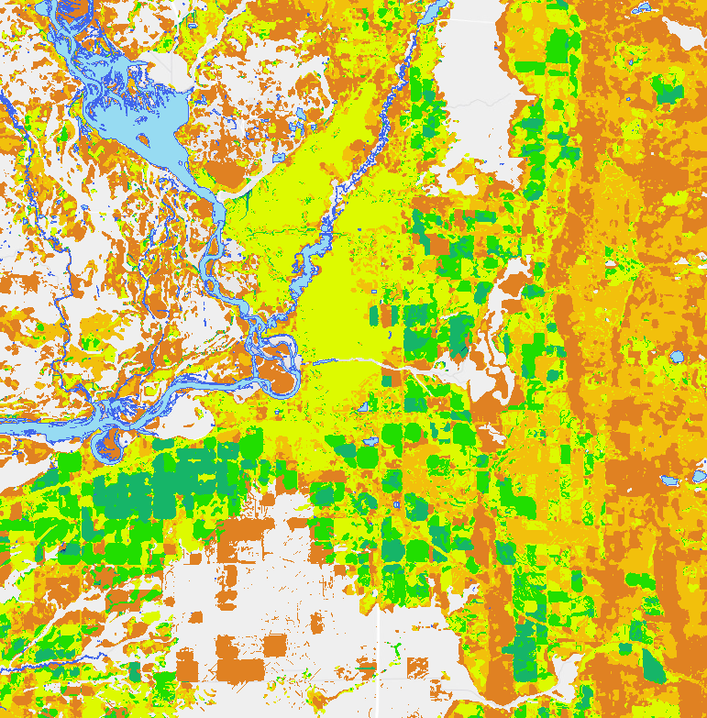
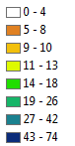
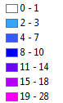
Example of FAO-56 crop water demand calculations with SWB
Estimated Irrigation
Amount (inches per year)
Potential Recharge
(inches per year)

